Slide 1


Arduino Class Programming with Examples
Part 1: Introduction
Alan Lomax
M8640
Notes:
MERG presentation (in two parts) for the Arduino SIG.
Prepared 2nd half of 2021.

Slide 2
Agenda
Motivation
Ground Work – Types and Structures
Basic Concepts - What is a Class ? How does it work?
Sample Code Fragments
Making the case: Why use a Class?
Notes:
Introductions – a little bit about myself!
Classes are a fundamental part of Object Oriented Programming and we will be covering this topic in two parts.
- first part … develop the general concepts … look at some code fragments to understand how they work … but not in depth.
- second part we will go through a complete example … with some live demos of class programming.
- Agenda Review above

Slide 3
Motivation
Part 1
Back to Agenda

Slide 4
Turntable
Stop
LCD
Speed
Control
12 VDC Power
Switch
Home
I2C
AI
CCW
Arduino NANO R3
On a Shield
Motor Shield
AI
CW
DO x 4
FLIP
DO x 3
DI
DI
DI
Hall Effect #1
Hall Effect #2
Hall Effect #3
Turntable
LED #1
LED #2
LED #3
12 VDC Motor
Magnet on Bridge
Notes:
This Slide builds up in steps .. .talk about each item as it appears.
The final software for this did not just appear to me in a vision … there were many iterations of it and countless problems to be solved along the way.
As the code got bigger it became more difficult to maintain (more importantly difficult to understand) .. If I left it for a few days it was difficult to get back immersed in it.
I had read about class programming, and I know that I had used software classes … so it was time to write my own!
Initially It was a self assigned study … told myself “I am going to learn this!” …. Which very quickly became “Wow .. This is so much easier”
My objective here … is to make the case for using Class programming in certain situations .. And in doing so take some of the mystery out of it.

Slide 5
Turntable SW Classes and Usage
Software LED object allow for blinking LED’s without using delay().
Can set on time, off time, read the current state and turn on or off.
LED
Button
Treat button inputs as a software object. Debounce without delay()
Motor
Treat motor as a software object. Stop, start, speed and direction
A general purpose timer class. Monitor an input pin Set ‘on delay’ and ‘off delay’ read the output property as to whether it is on or off. (Again no delay() function.)
DblDelay
Treat LCD display as a software object. Using the data sheet I implemented each command it could understand. Then I combined some of these to make up new and more powerful commands. (simplifying the sketch)
LCD
Notes:
So what classes do I end up creating.?
Talk them through – very high level. Each one evolved to fill a need.
There a few themes that might already be apparent to you.
None of the above is a complete program … but each is like a ‘LEGO BRICK’ which we can use to build something bigger
No calls to delay() (say a few words what delay() does) LED blinking example
Complexity can be hidden inside these LEGO BRICKS and it is not necessary to see that complexity to use the bricks.

Slide 6
Ground Work - Types and Structures
Part 2
Back to Agenda

Slide 7

Ground Work
Variable Types
int for Integer
bool for Boolean
string for textual data
float for floating point numbers
(and others)
Underneath all of these it is just bits and bytes of binary code.
When we declare a type we are describing how to interpret the binary
This is ‘bread and butter’ for programming in Arduino (and C++)
int x = 5; // normally a 16 bit integer
bool isPlaying = false; // a Boolean is true/false
string fname = “Fred”; // a string represents text
Notes:
These are fundamentals to build on. Part of this is getting us familiar with the vocabulary.
Later when I talk about a variable Type … I want everyone to know what that I am referring to.

Slide 8
Types and Structures
Struct{} (short for structure)
It is possible (and not uncommon) to define our own variable type which is a combination of the basic types given previously. A simple example:
struct structname {
String fname;
String lname;
};
structname fullName;// Declare a new variable of the new type
int x; // for comparison using a simple type
After defining the variable you can pass around the whole structure
as fullName or refer to the individual component parts like this:
fullName.fname = “Fred”;
fullName.lname = “Flintstone”;
Notes:
Structures are commonly used to handle related data as though it were a single item.
Not restricted to just two strings as shown .. Could be int, float etc. One structure could have many different component parts.
Next page talks about Chris Sharp’s presentations over the past few MERG sessions

Slide 9
Types and Structures
The structure is not restricted to basic data types.
The structure could include complete functions that manipulate data also.
struct structname {
String fname;
String lname;
int fnameLength() {
return fname.length();
};
};
Notes:
This is a trivial example (and not that clever) .. But it illustrates the point.

Slide 10
Types and Structures
In a recent MERG Arduino SIG meeting Chris Sharp gave a presentation on structures and in particular he was focusing on a Servo structure he designed.
As the concept of structures was introduced it became clear that at a high level the code would be easier to maintain and develop further.
But also the ‘code complexity’ was still in plain view.
(It was in essence a reorganizing of existing code.)
Notes:
You may recall Chris using color coding to show at a high level how blocks of code were moved around.
When I say plain view … I mean you had to be very aware of variable names to make sure they did not conflict.
Also the inner workings of the structure was in plain sight so the code was not a lot shorter or a lot easier to comprehend (until you got familiar with it.)

Slide 11
Basic Concepts - What is a Class ? - How does it work?
Part 3
Back to Agenda
Notes:
Enough with the ground work … move on

Slide 12
New Concept: A software Class
Very similar to a struct{ } a Class can be thought of as a user defined type but the big difference is it hides the implementation details.
This also means it hides complexity. To use a class you don’t need to know the implementation details
But we are MERG Arduino SIG and we want to know!
All of this to be covered …. So lets go!
Notes:
Using a class means you interact with it according to the authors wishes only.
Being able to look into a class and with what we are about to cover you can download and Inspect other peoples ‘classes’ and use them with confidence.
You can write your own classes.

Slide 13
Original to Struct{} to Class{}
Original Code
Code with struct{}
Code with class{}
Original code before struct{}
Reorganized
Code (Streamlined)
Reorganized
Code (Streamlined)
struct{}
class {}
Functions inside struct{}
Functions inside class{}
Notes:
Here we are showing how the code changes as we use structures .. .and then classes.
Start with high level view (I like using pictures!).
Starting with original code – messy, (the colour bars represent different functions in the program). It is one big ‘space’ where as the programmer you had to be very concerned about keeping track of variable names and what part of the program they applied to. The logic for all the parts was generally mixed together.
After reorganizing the code is streamlined. Slightly easier to comprehend. Overall though the program complexity is still in plain view.
With a class definition all of the ‘complexity’ is hidden from view inside the class. To use the class we may not even be aware of its internal functions.
The code for the class can be (and commonly is) kept in separate source files. Once the class software is developed it is saved away and is easily reused in multiple programs. Because the class code is in separate files sharing and reusing these as ‘building blocks’ is much easier.

Slide 14
A Software Class
on
output
off
Led2
Class Definition
Complex Stuff
Led2 myLed1 = Led2(13);
int pin = 13; // for comparison
Led2 myLed1 = Led2(13);
Led2 myLed2 = Led2(9);
Led2 myLed3 = Led2(8);
Member functions.
Led2 myLed1 = Led2(13);
Pin 8
Objects:
myLed1
myLed2
myLed3
Pin 9
Pin 13
Notes:
The blue box is my ‘shoebox’. Complexity may be hidden inside the shoebox (But as a user we don’t care)
Sticking out of the shoebox are three items .. Two inputs and one output (this is not hardware recall).
Terminology. on and off are called member functions. As we will see later inside the class definition there are software functions that implements these. And so the functions are ‘members of the class’.
Code box – one line .. Grows to three with clicks.
Sven has pointed out to me that writing the definition as "Led2 myLed1 = Led2(13);“ makes it easier to see the relationship with definition of a normal variable like "int pin = 13;" which you are familiar with. Here is where it is useful to think of Led2 as a type.
Do not be confused by the objects … they could be called anything we like … myLed1 .. myLed2 … myLed3 are just my arbitrary names.
Side notes …
On and Off do not make a compelling case but were working up to that.
The class is called Led2 because it was my second go at it and for a time I had two Led classes kicking around.
The colour coding (blue, green, red) I have added to the slides for emphasis and learning … do not expect to see these in your Arduino IDE !

Slide 15
Led2 is just an Example (We could be talking about a servo class)
Attach
Output Pin
Detach
Servo
Class Definition
Write
Output Pin
Output Pin
Objects:
myServo1
myServo2
myServo3
Output Pin
Notes:
The Picture hardly changes.

Slide 16
Sample Code Fragments
Part 4
Back to Agenda
Notes:
On the next few slides we will take a peek at some of the code fragments that will give you some insight as to how the class software is written.
I do need to emphasize though … these are just code fragments not complete solutions. We will get to the complete solution in part 2 of this talk.

Slide 17
A little Deeper: The Constructor
on
output
off
Led2
Class Definition
Complex Stuff
Led2 myLed1 = Led2(13);
on
Pin 13
off
myLed1
Complex Stuff
Notes:
This code line is calling a special function in the class called the constructor.
Why is it called that ? .. Because it constructs the object for us
What does that mean really? – talk it through … use an Americanism – the Cookie Cutter … (or Pastry Cutter)
Writing the class software is defining the pastry cutter shape. Using the class software is using that pastry cutter to stamp out all of those mince pies you just ate!

Slide 18
Even Deeper
class Led2 {
private:
int _pin; // the number of the LED pin
unsigned long _onTime; // milliseconds of on-time
unsigned long _offTime; // milliseconds of off-time
unsigned long _nextTime; // next time change in milliseconds
bool _blink; // true if we are in blinking mode, false if not
{ snip }
public:
Led2(byte pin); // Simple default definition
void off(); // Turn off the LED
void on(); // Turn on the LED
void update(); // Magic Sauce
{ snip }
}
Notes:
This code is part of the actual class definition (I have snipped out parts while I Introduce the terminology)
Class / class name … curly braces just like in a structure.
Some variables are declared private .. What does that mean? They are Inside the class and not available outside the shoebox.
Very important concept here … every time we create a new object it will get its own set of these internal variables
The names wont conflict and they survive as long as the object sticks around.
My naming convention .. Private variables start with an underscore .. Helps me keep it clear.
Public variables – are what is visible to us outside the shoebox.
You should recognize the constructor, and the other member functions off() and on()

Slide 19
A peek Under the Covers : The Constructor
Led2 Class
Led2 myLed1 = Led2(13);
Led2::Led2(byte pin) {
_pin = pin; // Save the passed pin
pinMode(_pin, OUTPUT); // define our output pin
off(); // call the off function
}
Notes:
Key point – every time we call the constructor a ‘new’ object is created and all of the internal class variables for one object are separate from any other object of same class.
The double colon is called the ‘scope resolution’ operator. Here it is letting the compiler know that the function Led2(byte pin) is within the scope of the class Led2.
Recall the meaning of the leading underscore which in this case is trivial. (Sometimes we might do validity checking before saving it.)
I hope people are underwhelmed with this … When we call the constructor it will set aside memory locations for the private variables and if we tell it to it will assign values to them.
In this case we are setting _pin and then using the standard Arduino function called pinMode. Note we have not actually sett the output to a value (yet).

Slide 20
A peek Under the Covers : the on() property
“on” Command
Led2 Class
myLed1.on(); // Outside the shoebox set the on property of myLed1 object
void Led2::on() {
_blink = false; // Turn off blink mode
_state = HIGH; // Set desired state LED
}
Notes:
Again I hope people are underwhelmed with this … the on property is just setting private internal values.
Inside the shoebox on() is a function that sets the private internal variable _state and _blink
I could have just made the state a public variable (not private) and then we could write to it directly.
Generally doing this is a poor idea as doing so does not allow the possibility of error checking and users could enter values you are not expecting.
Better to have a function .. Read the passed value (check it if needed) and then set the private variable.

Slide 21
The Magic Sauce: the update() method
Led2 Class
“update” method
myLed1.update(); // update the myLed1 object
void Led2::update() {
if (_blink) { // If in blinking mode look at timing first
if ( millis() >= _nextTime) { // It is time to do something.
_state = !_state; // swap states
_nextTime = millis() + (_state == HIGH ? _onTime : _offTime); // and calculate when next
// change of state is due
}
}
digitalWrite(_pin, _state); // update the actual output according to desired state
}
Notes:
Terminology first …. Property vs Method … often misused and I do fall into this trap.
Basically a property is a value that can set (written to) or read (obtained from) the object.
Whereas a method .. Just does something. Note the update method above has a return type of ‘void’ and also did not need any passed parameter.
Within the class properties and methods can both be implemented as functions. In some other languages the compiler can help with get and set of properties but not with the Arduino.
The update method is where it all happens. In your main program for each object you would call the update method frequently (in your loop code)
Talk it through (ignore the calculation of _nextTime for now)

Slide 22
Why use a Class?
Part 5
Back to Agenda

Slide 23
Why use a Class?
Comprehension (details are hidden, code is easier to understand)
Productivity (defining and using objects can be very quick)
Portability (The same class can be used in many sketches)
Testability (Testing, isolating and debugging is compartmentalized)
Inheritance (New classes can build on other classes)

Slide 24
The Key Points
Key Point #2: Although each of the objects gets its functionality from the same class definition, each object is independent and the objects do not interact .
Led2 Class Definition
Led2 myLed1(13);
Led2 myLed2(5);
Led2 myLed3(6);
Led2 myLed4(7);
Key Point #3: Reusability of class creating multiple objects that behave the same without exposing the complexity makes for coding efficiency.
myLed1 Object
Key Point #4: There is no such thing as magic!
myLed2,3,4 Objects
Key Point #1:
The object is defined by the class but is separate.
You do not need to know the inner workings of the class definition in order to use it.

Slide 25
Backup Material
Part 8

Slide 26







The Next Train Departs in:
Notes:
Using this PowerPoint break timer
This PowerPoint slide uses images, custom animation, and timing to provide a countdown timer that you can use in any presentation. When you open the template, you’ll notice that the timer is set at 00:00. However, when you start the slide show, the timer will start at the correct time and count down by 1-minute intervals until it gets to 1 minute. At that point, it will count down in two 30-seconds intervals to 00:00.

Slide 27
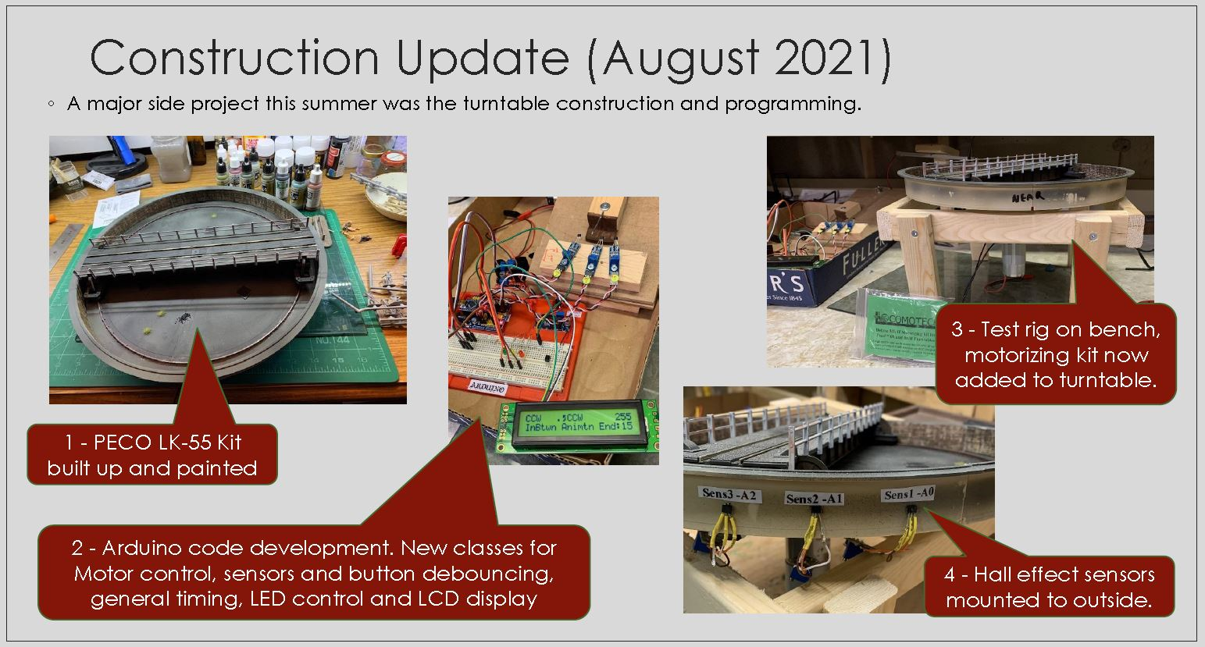
My Motivation
Notes:
Show people that this can be about modelling on railways.
It is not just deep in the weeds Arduino programming.

Slide 28
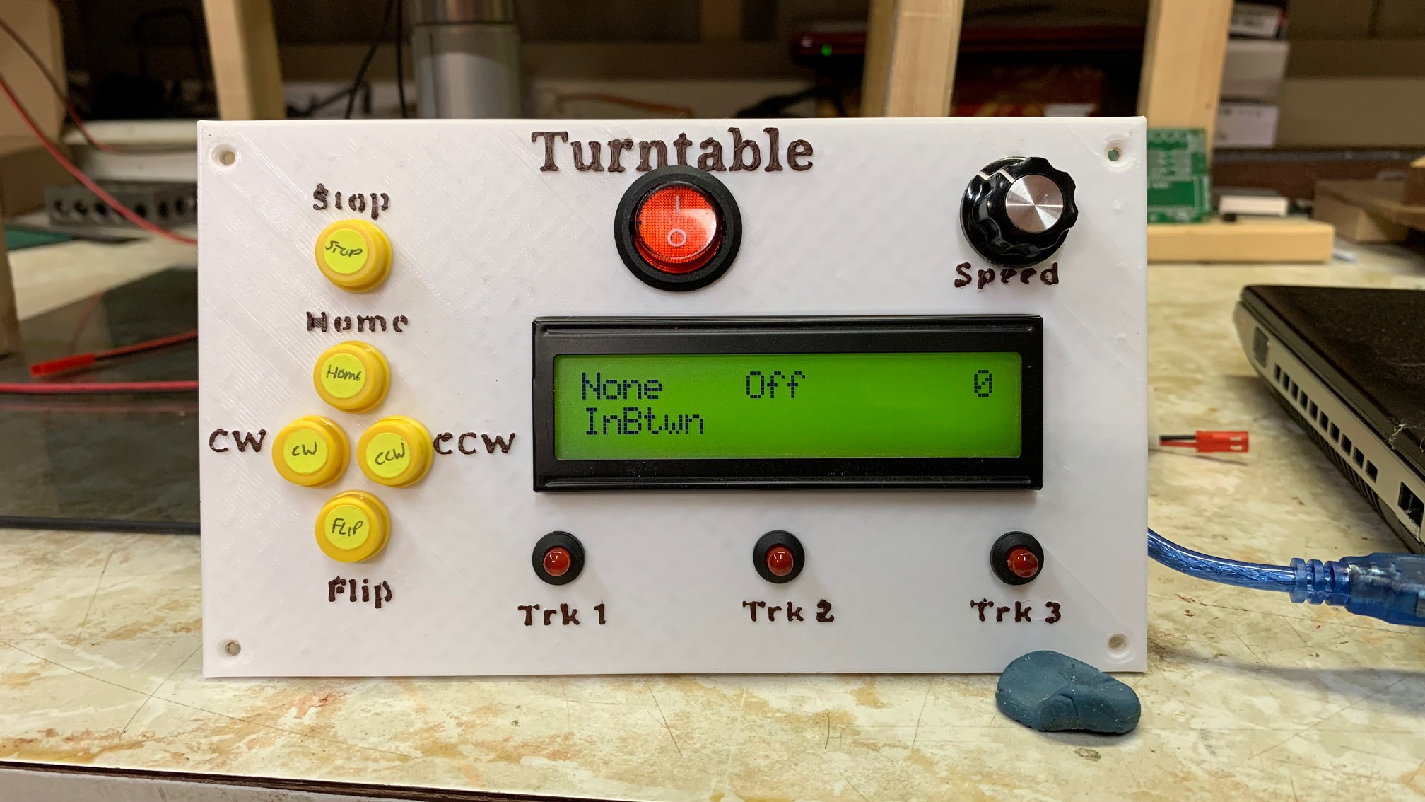
My Motivation
Notes:
User interface – 5 buttons .. One speed control potentiometer one LCD screen (6 data regions) showing 6 different status items, and 3 LED’s for when turntable bridge is in a specific position.
Other Inputs – 3 HALL effect sensors on outside of turntable well … detect micro magnets attached to bridge as it rotates.
Other outputs – DC motor control direction and speed control.
Logic – depending on button press move in the correct direction until hall effect sensor is detected.
All controlled by one Arduino NANO

Slide 29
References and Additional Material
Binary numbers and types :
https://learn.sparkfun.com/tutorials/data-types-in-arduino/all
http://users.ece.utexas.edu/~valvano/embed/chap3/chap3.htm
Alternate explanations on subject of Classes:
https://www.guru99.com/cpp-classes-objects.html
http://mypractic.com/lesson-7-classes-in-c-language-for-arduino-button-as-an-object/
https://www.geeksforgeeks.org/c-classes-and-objects/
http://paulmurraycbr.github.io/ArduinoTheOOWay.html

Slide 30
Arduino Class Programming with Examples
Part 2: Code Review & Demo
Alan Lomax
M8640
Notes:
MERG presentation for the Arduino SIG. Prepared 2nd half of 2021 for presenting when needed.
Dec 2021 – broke it up into a 2 part presentation to allow time for a show and tell session (in part 2)

Slide 31
Agenda
Recap from Last Time
Example Code
Inspecting the Led2 Class in Detail
Questions
Backup Material
Notes:
This is the second part of a chat about software Classes.
- In the first part we develop the general concepts … look at some code fragments to understand how they work … but not in depth.
- In todays second part we will go through a complete example … with some live demos of class programming.
- Agenda Review

Slide 32
Recap from Part 1
Part 1
Back to Agenda

Slide 33


Agenda From part 1
Notes:
Agenda from Part 1.
Remind people of what was covered …

Slide 34
Example Code
Part 2
Back to Agenda

Slide 35
Going a little Deeper
A class definition can be divided into two parts
a header file (*.h) and
a C++ program (*.cpp)
There are other ways of doing it but this is my way
This line creates a new object
Name of our Class is the Type
Led2
Class Definition
The header lets our sketch and the compiler know what is coming further down in our code. Specifically
- How to use the Led2 class to make a new object
- What properties and methods it has.
In your Sketch you put these two lines.
They don’t need to be one right after the other
The #include line does need to come first
(Typically it is right at the top of a sketch)
#include "Led2.h"
Led2 myLed1 = Led2(13);
int pin = 13; // for comparison
#include "Led2.h"
Led2 myLed1 = Led2(13);
Name of our New Object
Constructor with a passed parameter to be used when first constructing the object
Notes:
This is about using the class …. Not writing the class definition. (We will cover that later)
Note the definition is written as "Led2 myLed1 = Led2(13);“ which makes it easier to see the relationship with definition of a normal variable like "int pin = 13;"
Here is where it is useful to think of Led2 as a type.

Slide 36
Side discussion - File Locations
The header defines the ‘entry points’ for the functions but it is the cpp program that implements those functions. Both are required.
On the previous slide I indicated you would add the following line:
#include "Led2.h"
But where do the *.h and *.cpp files actually go?
If you use “double quotes” (as shown above) then put the two files in same directory as your main sketch. This is good while developing or testing.
If you use <angle brackets> then the two files must go in your libraries folder (under the folder where you keep your sketches.)
This is good for your final class code.
The use of angle brackets (<>) causes the compiler to search the default include directory. Using double quotes ("") causes it to search the current working directory and only if that search fails the default include directory.

Slide 37
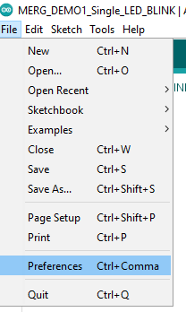
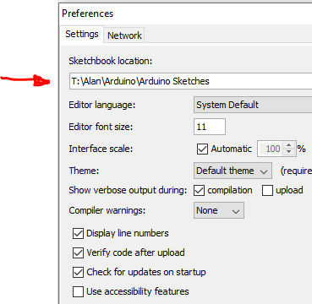
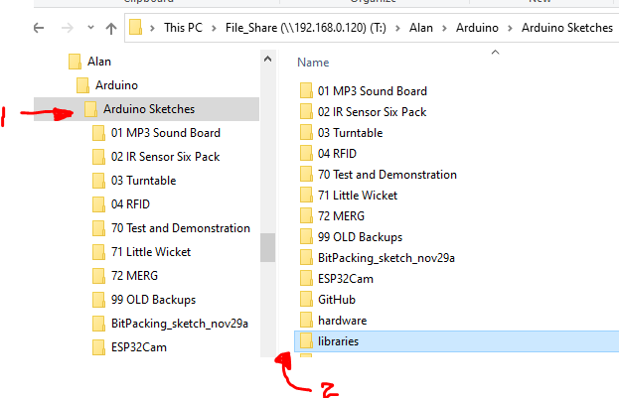
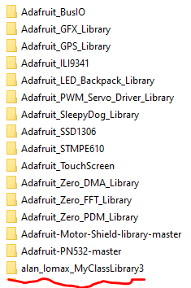
File Locations
This is my case (In the Arduino IDE)
File - Preferences
Note where your sketches are kept
Go to that folder and there should be a subfolder called libraries
Notes:
Within libraries subfolders are OK. I put my class stuff all in “MyClassLibrary”

Slide 38
The Header File
- a header file (*.h) and
- a C++ program (*.CPP)
/*****************************************************
** Led2_H **
** **
** This class implements standard LED on-off **
** logic on a pin you specify plus a configurable **
** blinking effect. It does so without any delay **
** calls. (no blocking code) **
*****************************************************
*/
class Led2 {
private:
int _pin; // the number of the LED pin
unsigned long _onTime; // milliseconds of on-time
unsigned long _offTime; // milliseconds of off-time
unsigned long _nextTime; // next time change in milliseconds
bool _blink; // true if we are in blinking mode, false if not
{ snip }
public:
Led2(byte pin); // Simple default definition
void update(); // update things based on elapsed time (call often)
void off(); // Turning off the LED (and sets blink to false)
void on(); // Turning on the LED (and sets blink to false)
{ snip }
};
Tell compiler we are defining a class
Some member variables (or member functions) are private
(completely inside the shoebox)
Some are public – available outside the class (They stick out of the shoebox)
This member function has same name as class and no other return type – it is the CONSTRUCTOR
This (incomplete) code is the header. Notice It tells the compiler what to expect in the cpp program … but it has no real executable code of its own.
Notes:
For simplicity and to fit the page some lines have been snipped out.
For the complete solution go to the GitHub page.

Slide 39
The C++ part
- a header file (*.h) and
- a C++ program (*.CPP)
#include "Led2.h"
Led2::Led2(byte pin) {
// Save the passed pin
_pin = pin;
init();
}
void Led2::init() {
pinMode(_pin, OUTPUT); // define our output pin
off(); // call the function that sets out LED to off initially
}
void Led2::off() {
_blink = false; // Turn off blink mode
_state = LOW; // Set the desired state - LED will turn off on next call to update
}
void Led2::on() {
_blink = false; // Turn off blink mode
_state = HIGH; // Set desired state LED will turn on with next call to update
}
void Led2::update() {
if (_blink) { // If in blinking mode look at timing first
if ( millis() >= _nextTime) { // It is time to do something.
_nextTime = millis() + (_state == LOW ? _onTime : _offTime); // and calculate when next
// change of state is due
_state = !_state; // swap states
}
}
digitalWrite(_pin, _state); // update the actual output according to desired state
}
Include the header
Here is our CONSTRUCTOR (name is same as class name). We pass it pin and all it does is save it in a private variable called _pin
Then call a separate function to initialize things.
Led2 myLed1 = Led2(13);
This double colon ( :: ) is called the ‘scope operator’.
It is telling the compiler (and us) that the name on the right is within the scope of the name on the left. This prevents naming conflicts between what is inside the shoe box and what is outside the shoebox. It is a little confusing for the constructor where the CLASS name (left side) is the same as the Constructor (right side)
The separate member function to initialize things is itself dirt simple .. It sets the pinMode and calls yet another member function called off()
The separate member functions on() and off() just set two internal member variables.
Note that at no point so far have we actually written anything to the output.
myLed1.on();
The Magic Sauce. A public method called update. If blink is true it checks if it is time to swap states .. Otherwise carry on. And finally write the _state to the _pin
Note: No delays, no blocking code. Update executes very quickly.
myLed1.update();
Notes:
The public functions are what the outside world (ie your main program) sees.
All of the internal code is hidden complexity.
The term member is used to indicate that these items are part of the class definition and not normal everyday code. A member variable or a member function is inside the shoe box.
Most of the methods (or functions if you prefer) just get or set internal variables. In quick and get out.
The update method reads and acts on the internal variables … typically it is doing most of the work.

Slide 40
In your Main Program
Defining it before setup makes myLed1 a global variable. It can be accessed in setup or in loop code.
#include “Led2.h”
Led2 myLed1 = Led2(13);
void setup() {
myLed1.onTime(50); // Set LED onTime (50 ms)
myLed1.offTime(300); // Set LED offTime (300 ms)
myLed1.blink(); // turn on blink mode
}
void loop()
{
myLed1.update(); // call update frequently
}
In setup configure any settings we want.
Loop code could not be simpler. The work is done inside the class checking millis() and doing the work.

Slide 41
Summary: How it all works together
1) Use The class definition and create an object like so:
Led2 myLed1 = Led2(13);
13
output
13
on
on
on
Led2
Class Definition
Object
myLed1
_pin = 13
_state = ON
Object
myLed1
_pin = 13
_state = OFF
pinMode(_pin, OUTPUT);
off
off
off
update
update
update
2) constructor runs and sets private (internal to class) variables:
_pin = 13, _state=OFF
and the mode of _pin is set to OUTPUT
3) In loop code we call the update method myLed1.update() which executes the line digitalWrite(_pin, _state)
Not too much else happens- we just turned off a pin that was probably already off!
5) When next our loop code calls myLed1.update() it will check the local variables _state and writes it to the output pin.
It is only at this point our LED will turn ON.
4) Now lets say we called the on method myLed1.on() All this does is set the local variable _state to on. At this point still nothing happens because _state is just a private variable inside our class.

Slide 42
Inspecting the Led2 Class in detail
Part 3
Back to Agenda

Slide 43

The full Led2 class
Led2 Class
Output (Pin)
“on” Command
“off” Command
“update()”
Complexity is hidden inside the shoebox
state (T / F)
“blink” Command
“onTime (ms)”
“offTime (ms)”
“update()”
On and Off commands are hardly a compelling usage case
A blink command for our class makes it a bit more interesting
User definable on time and off times - better
Blinking an LED output without ever calling delay() is an example of hidden complexity
As a user you don’t need to know how it works, only that it does work!

Slide 44
Live Demo Time
Single LED blinking
Multiple LEDs blinking with different patterns
Multiple LEDs blinking with different patterns and a Servo sweep
Notes:
Share screen show code … load code wink over to second camera describe what people are seeing.
Change timing and show effect. Pause for discussion.
Look into class code – discuss how it works.
Move to next example.

Slide 45
Going deeper with a code review….
Led2 Class
Lets take a look at and talk through the code:
Latest: https://github.com/Alan-Lomax/Led2
A snapshot also included in Backup.

Slide 46
Recap
A blueprint for making software ‘objects’
A way of making re-usable software parts
A way of hiding complexity
A user defined variable type
A fundamental part of Object Oriented Programming

Slide 47
Questions?
Part 4
Additional Backup Material Follows
Back to Agenda

Slide 48
The Next Train Departs in:
Notes:
Using this PowerPoint break timer
This PowerPoint slide uses images, custom animation, and timing to provide a countdown timer that you can use in any presentation. When you open the template, you’ll notice that the timer is set at 00:00. However, when you start the slide show, the timer will start at the correct time and count down by 1-minute intervals until it gets to 1 minute. At that point, it will count down in two 30-seconds intervals to 00:00.

Slide 49
Backup Material
Part 5
Back to Agenda

Slide 50
Some More Examples (+ Inspecting Class Programming)
DblDelay https://github.com/Alan-Lomax/DblDelay
Timer https://github.com/Alan-Lomax/Timer
Button https://github.com/Alan-Lomax/Button
LCD2x20 https://github.com/Alan-Lomax/LCD_NHD2x20
Led2 https://github.com/Alan-Lomax/Led2

Slide 51

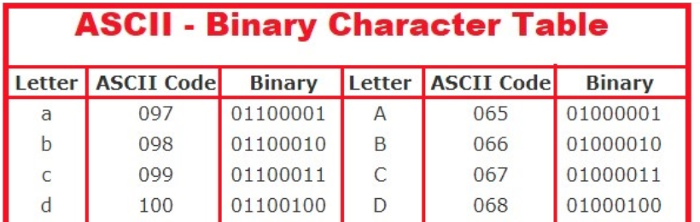
Ground Work – Types and Structures
byte x = 65;
char myLetter = ‘A’;
In binary both of these are the same bit pattern 01000001
The computer does not care.
It is only how we interpret the two variables that matters.
Lots of on line help is available (see references)

Slide 52
Why Not use a Class?
For some applications they are not needed so why use a class to do what might be a trivial thing
Classes are still programs and programs do have bugs.
All that hidden complexity might represent a can of worms if you did not write the code but still need to dig into it.
There is a learning curve, especially if a class has lots of properties and methods.
Changing a class can have knock on effects to many programs that depend on it working a certain way

Slide 53
Lessons Learned
IMO: The hardest part is knowing what properties and methods are available with a given (non-trivial) class.
Not only what they are but also the many options available for a given property can also be quite involved.
These aspects are often poorly documented. Realizing the true power of a class is a challenge under such conditions and users might be reluctant to accept the implementation at face value.
An example sketch demonstrating usage of some properties is helpful – but is not sufficient if there are many options and alternate uses.

Slide 54
Led2.H
These two lines are called an #include guard.
They prevent including the same code twice.
First line - IF NOT DEFINED (name)
Second line – DEFINE (name)
At end of the header file – END IF
#ifndef MY_Led2_H
#define MY_Led2_H
#include "Arduino.h"
/*
*****************************************************
** Led2_H **
** **
** This class implements standard LED on-off **
** logic on a pin you specify plus a configurable **
** blinking effect. It does so without any delay **
** calls. (no blocking code) **
*****************************************************
*/
class Led2 {
private:
int _pin; // the number of the LED pin
long _onTime; // milliseconds of on-time
long _offTime; // milliseconds of off-time
bool _blink; // true if we are in blinking mode, false if not
int _state; // ledstate used to set the LED
unsigned long _previousMillis; // the last time LED was updated
void init(); // Initialization code
public:
Led2(byte pin); // Simple default definition without a pre specified on and off time.
Led2(byte pin, long on, long off); // this definition includes the on and off time values from the outset
void update(); // update things based on elapsed time (call this as often as possible)
bool getState(); // Return the current state of LED
bool getBlink(); // return the LEDs current blinking state (true / false)
void onTime(long on); // Set the onTime to a new value
long onTime(); // Return the current onTime
void offTime(long off); // Set the offTime to a new value
long offTime(); // Return the current offTime
void off(); // Set the On time to zero and the Off time to 500 - Turning off the LED
void on(); // Set the Off time to zero and the On time to 500 - Turning on the LED
void blink(); // set the LED to a blinking state using the previously set timing values
};
#endif

Slide 55
Led2.CPP (1/3)
#include "Led2.h"
Led2::Led2(byte pin, long on, long off) {
// Save the passed pin and timing values into the equivalent local variables (with underscore)
_pin = pin;
_onTime = on;
_offTime = off;
// Initializing code is kept separate just for clarity.
init();
}
Led2::Led2(byte pin) {
// Save the passed pin
_pin = pin;
init();
}
void Led2::init() {
pinMode(_pin, OUTPUT);
// Initialize local variables for the new class member
_state = LOW; // start with LED on the off condition
_blink = false; // no blinking at initialization
off(); // call the function that sets out LED to off initially
}

Slide 56
Led2.CPP (2/3)
void Led2::update() {
// check to see if it's time to change the state of the LED
unsigned long currentMillis = millis();
if (!_blink) { // If not in blinking mode just look at on or off conditions
if (_state == LOW) {
digitalWrite(_pin, LOW); // Turn off the actual LED.
}
else if (_state == HIGH) {
digitalWrite(_pin, HIGH); // Turn on the actual LED.
}
}
else { // We are in blinking mode so cycle accordingly
if ((_state == HIGH) && (currentMillis - _previousMillis >= _onTime)) {
_state = LOW; // Turn it off
_previousMillis = currentMillis; // Remember the time
}
else if ((_state == LOW) && (currentMillis - _previousMillis >= _offTime)) {
_state = HIGH; // turn it on
_previousMillis = currentMillis; // Remember the time
}
digitalWrite(_pin, _state); // update the actual LED.
}
}
bool Led2::getState() {
// return the current state of the led (True or False)
return _state;
}
bool Led2::getBlink() {
// return the current blink state of the led (True or False)
return _blink;
}

Slide 57
Led2.CPP (3/3)
void Led2::onTime(long on) {
// update the desired on time of the led
_onTime = on;
}
long Led2::onTime() {
// return the current on time of the led
return _onTime;
}
void Led2::offTime(long off) {
// update the desired off time of the led
_offTime = off;
}
long Led2::offTime() {
// return the current off time of the led
return _offTime;
}
void Led2::off() {
_blink = false; // Turn off blink mode
_state = LOW; // Set the desired state - LED will turn off on next call to update
}
void Led2::on() {
_blink = false; // Turn off blink mode
_state = HIGH; // Set the desired state - LED will turn on on next call to update
}
void Led2::blink() {
_blink = true; // Turn on blink mode
// Set the desired state - LED will start blinking as of next call to update
}

Slide 58
References and Additional Material
Binary numbers and types :
https://learn.sparkfun.com/tutorials/data-types-in-arduino/all
http://users.ece.utexas.edu/~valvano/embed/chap3/chap3.htm
Alternate explanations on subject of Classes:
https://www.guru99.com/cpp-classes-objects.html
http://mypractic.com/lesson-7-classes-in-c-language-for-arduino-button-as-an-object/
https://www.geeksforgeeks.org/c-classes-and-objects/
http://paulmurraycbr.github.io/ArduinoTheOOWay.html

